Slide 1
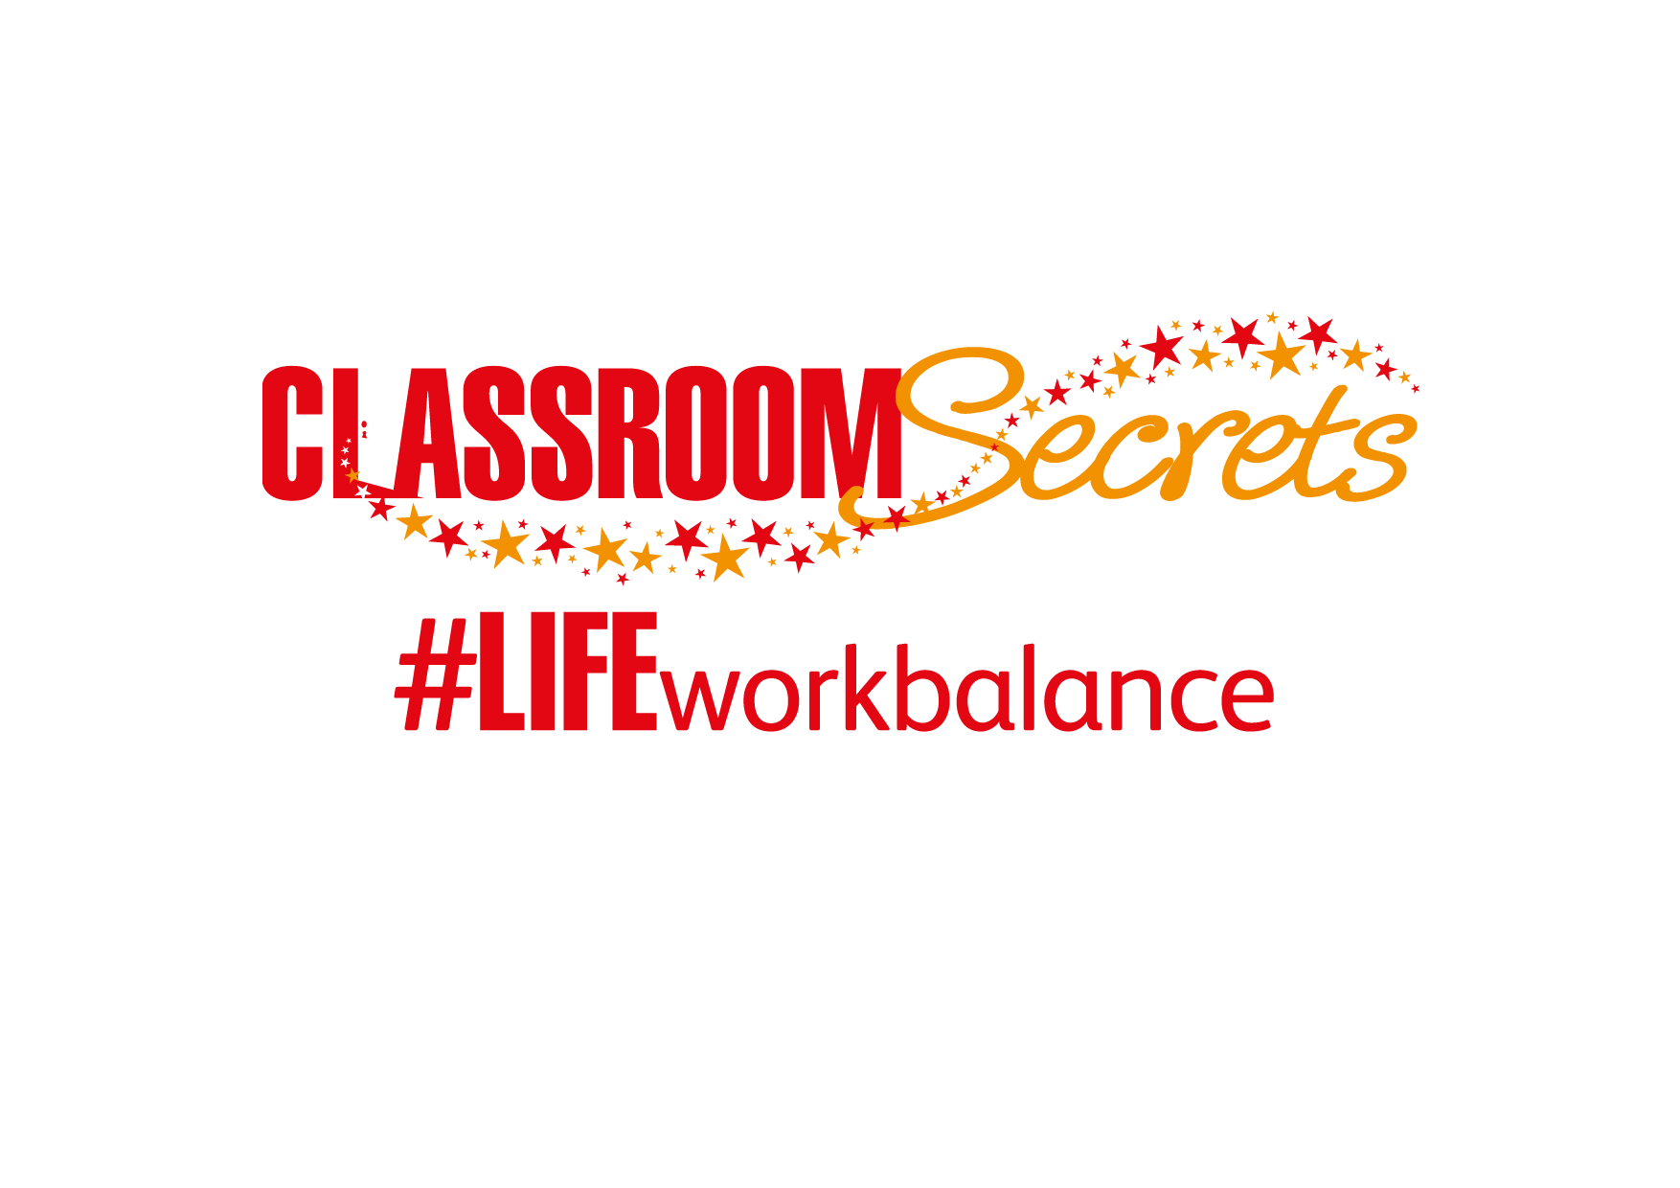
LIFE/work balance
We have started a #LIFEworkbalance campaign and we need your help to complete our LIFE/work balance survey.
We hope to publish the results soon, so please give 15 minutes of your time to help us get a true picture of school life.
Want to be a part of this campaign? Take the survey on our website and share it with your colleagues!
© Classroom Secrets Limited 2019

Slide 2
Year 4 – Summer Block 2 – Paragraphs – Identifying Paragraphs - Fiction
About This Resource:
This PowerPoint has been designed to support your teaching of this small step. It includes a starter activity and an example of each question from the Varied Fluency and Application and Reasoning resources also provided in this pack. You can choose to work through all examples provided or a selection of them depending on the needs of your class.
National Curriculum Objectives:
English Year 4: Use of paragraphs to organise ideas around a theme
English Year 4: Draft and write by organising paragraphs around a theme
English Year 4: Draft and write in non-narrative material, using simple organisational devices [for example, headings and sub-headings]
More resources from our Grammar, Punctuation and Spelling scheme of work.
Did you like this resource? Don’t forget to review it on our website.
© Classroom Secrets Limited 2019

Slide 3
Year 4 – Summer Block 2 – Paragraphs – Identifying Paragraphs - Fiction
Notes and Guidance:
In Year 3 Summer Block 2, children were introduced to paragraphs in narrative, reports and biographies.
This step builds on previous learning, allowing children to identify paragraphs within different fiction and non-fiction texts.
Paragraphs are used to break up a piece of writing, making it easier to read.
Ideas are grouped together, with a new paragraph starting with a new idea. For example: In a fiction text, the first paragraph may start with the introduction of a character. The second paragraph may describe a part of the setting. In a non-fiction text, the first paragraph may introduce the topic and the second may provide an explanation of the topic.
The first line of a new paragraph may be indented, or there may be line break from the last sentence of the previous paragraph.
Focused Questions
How many paragraphs are in this piece of writing?
How do you know that a new paragraph should begin here?
© Classroom Secrets Limited 2019

Slide 4
Year 4 – Summer Block 2 – Paragraphs
Step 1: Identifying Paragraphs - Fiction
© Classroom Secrets Limited 2019

Slide 5
Introduction
Reorder the sentences below into two paragraphs.
All of a sudden, the naughty puppy broke free from his lead at the entrance and made his way enthusiastically into the library.
It wobbled and she fell, sending her pile of papers and books flying into the air which landed in a disorganised mess on top of her.
It was finally Friday and the library was a hive of activity. Everyone was going about their particular searches in the usual quiet and respectful manner.
She didn’t notice the excited puppy charging round the corner of the bookshelf, straight into the bottom rung of the ladder.
The librarian was busy up the ladder, returning books to the shelves and humming happily to herself.
© Classroom Secrets Limited 2019

Slide 6
Introduction
Reorder the sentences below into two paragraphs.
Example answer: It was finally Friday and the library was a hive of activity. Everyone was going about their particular searches in the usual quiet and respectful manner. All of a sudden, the naughty puppy broke free from his lead at the entrance and made his way enthusiastically into the library.
The librarian was busy up the ladder, returning books to the shelves and humming happily to herself. She didn’t notice the excited puppy charging round the corner of the bookshelf, straight into the bottom rung of the ladder. It wobbled and she fell, sending her pile of papers and books flying into the air which landed in a disorganised mess on top of her.
© Classroom Secrets Limited 2019

Slide 7
Varied Fluency 1
Identify the paragraphs in the text by writing the first two words of each.
Her head was thick with confusion as she watched the sharks swimming beneath her. She remained motionless to avoid disturbing them, safe in the knowledge that this would prevent them from noticing her. Sure enough, she seemed invisible to the monsters below.
Without warning, a dull clunking sound broke the silence causing the sharks to dart about swiftly beneath her. Where it had come from, she wasn’t sure. There it was again! She started to panic more urgently, dropping her camera as she spotted one of the sharks eyeballing her from below.
What should she do? She had so much brilliant footage on there that she couldn’t bare to lose it, but was her camera really more important than saving herself? She had to react, and fast!
© Classroom Secrets Limited 2019

Slide 8
Varied Fluency 1
Identify the paragraphs in the text by writing the first two words of each.
Her head, Without warning, What should
Her head was thick with confusion as she watched the sharks swimming beneath her. She remained motionless to avoid disturbing them, safe in the knowledge that this would prevent them from noticing her. Sure enough, she seemed invisible to the monsters below.
Without warning, a dull clunking sound broke the silence causing the sharks to dart about swiftly beneath her. Where it had come from, she wasn’t sure. There it was again! She started to panic more urgently, dropping her camera as she spotted one of the sharks eyeballing her from below.
What should she do? She had so much brilliant footage on there that she couldn’t bare to lose it, but was her camera really more important than saving herself? She had to react, and fast!
© Classroom Secrets Limited 2019

Slide 9
Varied Fluency 2
Which paragraph describes the start of some action?
Her head was thick with confusion as she watched the sharks swimming beneath her. She remained motionless to avoid disturbing them, safe in the knowledge that this would prevent them from noticing her. Sure enough, she seemed invisible to the monsters below.
Without warning, a dull clunking sound broke the silence causing the sharks to dart about swiftly beneath her. Where it had come from, she wasn’t sure. There it was again! She started to panic more urgently, dropping her camera as she spotted one of the sharks eyeballing her from below.
What should she do? She had so much brilliant footage on there that she couldn’t bare to lose it, but was her camera really more important than saving herself? She had to react, and fast!
Paragraph 1
Paragraph 2
Paragraph 3
© Classroom Secrets Limited 2019

Slide 10
Varied Fluency 2
Which paragraph describes the start of some action?
Her head was thick with confusion as she watched the sharks swimming beneath her. She remained motionless to avoid disturbing them, safe in the knowledge that this would prevent them from noticing her. Sure enough, she seemed invisible to the monsters below.
Without warning, a dull clunking sound broke the silence causing the sharks to dart about swiftly beneath her. Where it had come from, she wasn’t sure. There it was again! She started to panic more urgently, dropping her camera as she spotted one of the sharks eyeballing her from below.
What should she do? She had so much brilliant footage on there that she couldn’t bare to lose it, but was her camera really more important than saving herself? She had to react, and fast!
Paragraph 1
Paragraph 2
Paragraph 3
© Classroom Secrets Limited 2019

Slide 11
Varied Fluency 3
True or false? The sentence below could be added to the first paragraph.
Her head was thick with confusion as she watched the sharks swimming beneath her. She remained motionless to avoid disturbing them, safe in the knowledge that this would prevent them from noticing her. Sure enough, she seemed invisible to the monsters below.
Without warning, a dull clunking sound broke the silence causing the sharks to dart about swiftly beneath her. Where it had come from, she wasn’t sure. There it was again! She started to panic more urgently, dropping her camera as she spotted one of the sharks eyeballing her from below.
What should she do? She had so much brilliant footage on there that she couldn’t bare to lose it, but was her camera really more important than saving herself? She had to react, and fast!
“She didn’t have time to wonder what the shark may do next.”
© Classroom Secrets Limited 2019

Slide 12
Varied Fluency 3
True or false? The sentence below could be added to the first paragraph.
False, in the first paragraph the sharks have not yet noticed her.
Her head was thick with confusion as she watched the sharks swimming beneath her. She remained motionless to avoid disturbing them, safe in the knowledge that this would prevent them from noticing her. Sure enough, she seemed invisible to the monsters below.
Without warning, a dull clunking sound broke the silence causing the sharks to dart about swiftly beneath her. Where it had come from, she wasn’t sure. There it was again! She started to panic more urgently, dropping her camera as she spotted one of the sharks eyeballing her from below.
What should she do? She had so much brilliant footage on there that she couldn’t bare to lose it, but was her camera really more important than saving herself? She had to react, and fast!
“She didn’t have time to wonder what the shark may do next.”
© Classroom Secrets Limited 2019

Slide 13
Reasoning 1
The sentence ‘The lions…’ should be the start of a new paragraph.
Do you agree? Explain your answer.
Ivan was a very clever iguana. In fact, he was the cleverest of all the iguanas at San Diego Zoo. He was the boss, the captain, the chief and everybody there knew it. Not everybody agreed with it though.
Being an iguana didn’t make it easy as there were plenty of other animals who were much larger and stronger than Ivan. The lions in particular were proving to be extremely difficult. They thought that the biggest and most powerful should be in charge. So far, Ivan had managed to keep his position as the boss of the animal enclosure, but the lions were beginning to roar more loudly with each passing day. This was making some of the other predators sit up and listen, and Ivan was now beginning to fret.
His trusty followers were trying their best to help him but they were just too small. They needed a larger animal, someone who the others would respect and listen to, to join their gang. Ivan, being ever so clever, had hatched a magnificent plan. It just couldn’t fail, could it?
© Classroom Secrets Limited 2019

Slide 14
Reasoning 1
The sentence ‘The lions…’ should be the start of a new paragraph.
Do you agree? Explain your answer.
The statement is not correct because…
Ivan was a very clever iguana. In fact, he was the cleverest of all the iguanas at San Diego Zoo. He was the boss, the captain, the chief and everybody there knew it. Not everybody agreed with it though.
Being an iguana didn’t make it easy as there were plenty of other animals who were much larger and stronger than Ivan. The lions in particular were proving to be extremely difficult. They thought that the biggest and most powerful should be in charge. So far, Ivan had managed to keep his position as the boss of the animal enclosure, but the lions were beginning to roar more loudly with each passing day. This was making some of the other predators sit up and listen, and Ivan was now beginning to fret.
His trusty followers were trying their best to help him but they were just too small. They needed a larger animal, someone who the others would respect and listen to, to join their gang. Ivan, being ever so clever, had hatched a magnificent plan. It just couldn’t fail, could it?
© Classroom Secrets Limited 2019

Slide 15
Reasoning 1
The sentence ‘The lions…’ should be the start of a new paragraph.
Do you agree? Explain your answer.
The statement is not correct because it adds further explanation to the sentence before, so would not make sense in a new paragraph.
Ivan was a very clever iguana. In fact, he was the cleverest of all the iguanas at San Diego Zoo. He was the boss, the captain, the chief and everybody there knew it. Not everybody agreed with it though.
Being an iguana didn’t make it easy as there were plenty of other animals who were much larger and stronger than Ivan. The lions in particular were proving to be extremely difficult. They thought that the biggest and most powerful should be in charge. So far, Ivan had managed to keep his position as the boss of the animal enclosure, but the lions were beginning to roar more loudly with each passing day. This was making some of the other predators sit up and listen, and Ivan was now beginning to fret.
His trusty followers were trying their best to help him but they were just too small. They needed a larger animal, someone who the others would respect and listen to, to join their gang. Ivan, being ever so clever, had hatched a magnificent plan. It just couldn’t fail, could it?
© Classroom Secrets Limited 2019

Slide 16
Application 1
Write the next paragraph in the story using the word bank below.
Ivan was a very clever iguana. In fact, he was the cleverest of all the iguanas at San Diego Zoo. He was the boss, the captain, the chief and everybody there knew it. Not everybody agreed with it though.
Being an iguana didn’t make it easy as there were plenty of other animals who were much larger and stronger than Ivan. The lions in particular were proving to be extremely difficult. They thought that the biggest and most powerful should be in charge. So far, Ivan had managed to keep his position as the boss of the animal enclosure, but the lions were beginning to roar more loudly with each passing day. This was making some of the other predators sit up and listen, and Ivan was now beginning to fret.
His trusty followers were trying their best to help him but they were just too small. They needed a larger animal, someone who the others would respect and listen to, to join their gang. Ivan, being ever so clever, had hatched a magnificent plan. It just couldn’t fail, could it?
plan | win | clever
lion | elephant | wise
© Classroom Secrets Limited 2019

Slide 17
Application 1
Write the next paragraph in the story using the word bank below.
Various possible answers. Paragraphs should follow on from the text.
Ivan was a very clever iguana. In fact, he was the cleverest of all the iguanas at San Diego Zoo. He was the boss, the captain, the chief and everybody there knew it. Not everybody agreed with it though.
Being an iguana didn’t make it easy as there were plenty of other animals who were much larger and stronger than Ivan. The lions in particular were proving to be extremely difficult. They thought that the biggest and most powerful should be in charge. So far, Ivan had managed to keep his position as the boss of the animal enclosure, but the lions were beginning to roar more loudly with each passing day. This was making some of the other predators sit up and listen, and Ivan was now beginning to fret.
His trusty followers were trying their best to help him but they were just too small. They needed a larger animal, someone who the others would respect and listen to, to join their gang. Ivan, being ever so clever, had hatched a magnificent plan. It just couldn’t fail, could it?
plan | win | clever
lion | elephant | wise
© Classroom Secrets Limited 2019

Slide 18
Reasoning 2
Why does the sentence “His trusty...” start a new paragraph.
Explain how you know.
Ivan was a very clever iguana. In fact, he was the cleverest of all the iguanas at San Diego Zoo. He was the boss, the captain, the chief and everybody there knew it. Not everybody agreed with it though.
Being an iguana didn’t make it easy as there were plenty of other animals who were much larger and stronger than Ivan. The lions in particular were proving to be extremely difficult. They thought that the biggest and most powerful should be in charge. So far, Ivan had managed to keep his position as the boss of the animal enclosure, but the lions were beginning to roar more loudly with each passing day. This was making some of the other predators sit up and listen, and Ivan was now beginning to fret.
His trusty followers were trying their best to help him but they were just too small. They needed a larger animal, someone who the others would respect and listen to, to join their gang. Ivan, being ever so clever, had hatched a magnificent plan. It just couldn’t fail, could it?
© Classroom Secrets Limited 2019

Slide 19
Reasoning 2
Why does the sentence “His trusty...” start a new paragraph.
Explain how you know.
It starts a new paragraph because…
Ivan was a very clever iguana. In fact, he was the cleverest of all the iguanas at San Diego Zoo. He was the boss, the captain, the chief and everybody there knew it. Not everybody agreed with it though.
Being an iguana didn’t make it easy as there were plenty of other animals who were much larger and stronger than Ivan. The lions in particular were proving to be extremely difficult. They thought that the biggest and most powerful should be in charge. So far, Ivan had managed to keep his position as the boss of the animal enclosure, but the lions were beginning to roar more loudly with each passing day. This was making some of the other predators sit up and listen, and Ivan was now beginning to fret.
His trusty followers were trying their best to help him but they were just too small. They needed a larger animal, someone who the others would respect and listen to, to join their gang. Ivan, being ever so clever, had hatched a magnificent plan. It just couldn’t fail, could it?
© Classroom Secrets Limited 2019

Slide 20
Reasoning 2
Why does the sentence “His trusty...” start a new paragraph.
Explain how you know.
It starts a new paragraph because it is the beginning of a new theme discussing Ivan’s plan.
Ivan was a very clever iguana. In fact, he was the cleverest of all the iguanas at San Diego Zoo. He was the boss, the captain, the chief and everybody there knew it. Not everybody agreed with it though.
Being an iguana didn’t make it easy as there were plenty of other animals who were much larger and stronger than Ivan. The lions in particular were proving to be extremely difficult. They thought that the biggest and most powerful should be in charge. So far, Ivan had managed to keep his position as the boss of the animal enclosure, but the lions were beginning to roar more loudly with each passing day. This was making some of the other predators sit up and listen, and Ivan was now beginning to fret.
His trusty followers were trying their best to help him but they were just too small. They needed a larger animal, someone who the others would respect and listen to, to join their gang. Ivan, being ever so clever, had hatched a magnificent plan. It just couldn’t fail, could it?
© Classroom Secrets Limited 2019

