Slide 1
Friday 8th January
Year 2
If you have any questions or need any support please do not hesitate to get in touch:
aaskew@looeprimary.co.uk
(I will get back to ASAP but please bear with me.)

Slide 2
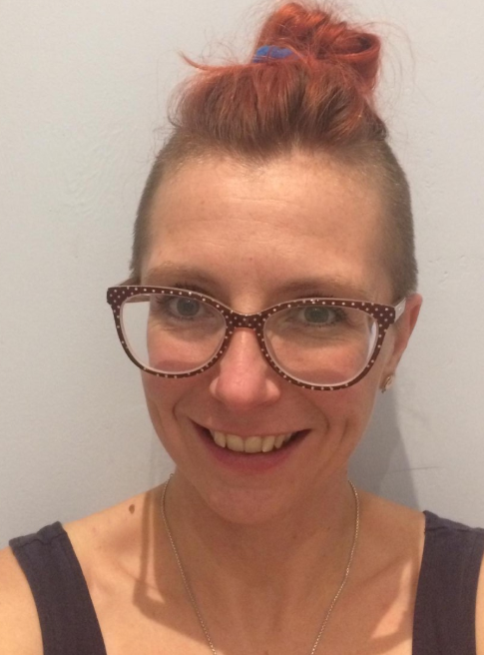
Hello
Hello wonderful Kilminorth class! Its Mrs Askew here…you may remember me from September! But to help jog your memory I have included a smiley photo!
First, I would like to wish you all a very happy New Year, and I hope you all had a magical Christmas!
I have the pleasure of supporting your learning for a short while…I am hoping to present this in a powerpoint just like this one.
Each day I will set you a math activity, English activity and another curriculum activity. Please make sure you open the appropriate year group. (All year groups will have the same English and curriculum activity, but the amount of work expected from the different year groups will differ. This will help those children who have siblings in different year groups.)
We appreciate that these are strange times, so please do not let home schooling feel stressful. I am here to support you as much as possible.
I am working on the assumption that not everyone will have access to a printer so we will need to be creative. I am to make lessons ‘hand-on’ or so you can work direct from the screen.
Take a break throughout the learning!

Slide 3
Reading
Reading supports so many skills so it would fantastic if you can encourage your child to read daily.
Remember to use Reading eggs to support you.
As you read ask your child to predict what might happen next.
What might a character be feeling?
Can they draw a picture of their favourite character and label it?

Slide 4
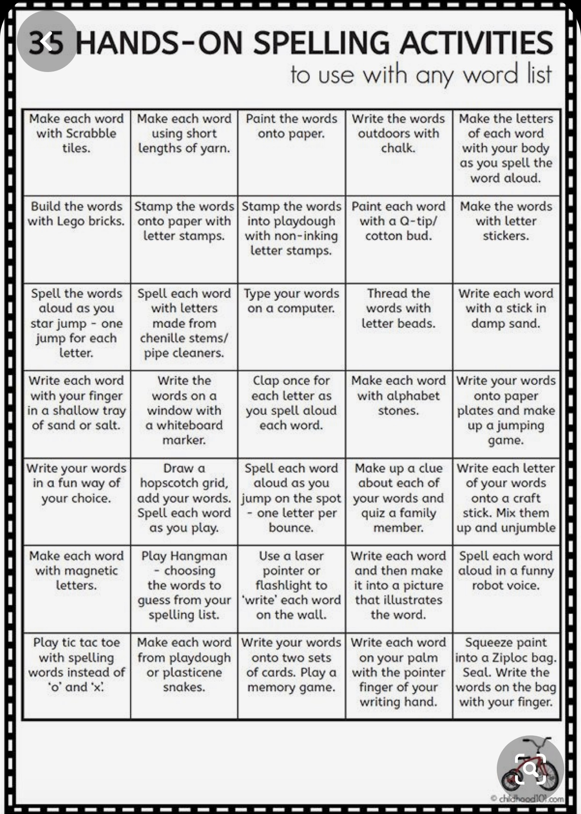
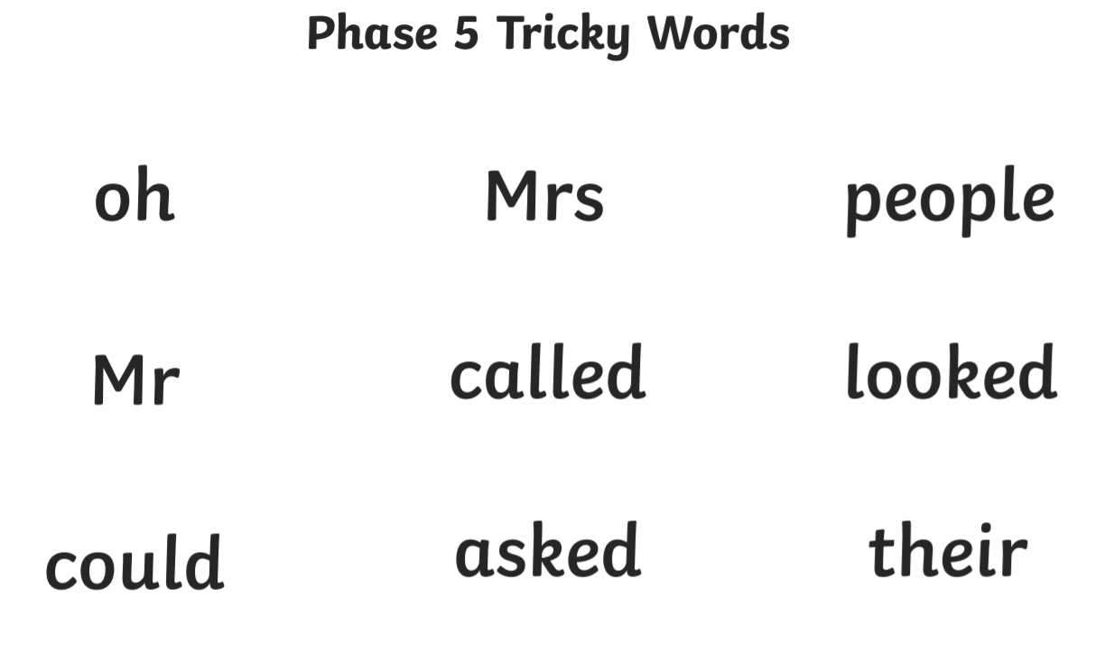
Spelling
Here are some fun ways you can practice your spellings, can you think of any other fun ways that we can share with the class?

Slide 5
PSHE I understand that if I persevere I can tackle challenges. I can set simple goals.
This term we will focus on being perseverant and not giving up.
When things are tough or challenging it can help to set a small goal. You can then celebrate these goals as you achieve them.
Doing school work at home can be tricky so why not set yourself small goals to help you…
Here are some examples of goals you may set:
I will get dressed each day before 9am (it is hard to feel awake and ready to learn if you are still in your PJs!)
I will exercise at least once a day (Joe Wicks, or Jump Start Jonny have fun videos)
I would love to hear what goals you set for yourself! Feel free to ask an adult to email me your goals aaskew@looeprimary.co.uk

Slide 6
maths

Slide 7
Maths
Please work through the slides, they will help to explain the activities.
There are some questions for you to discuss, you may wish to record your answers on a piece of paper.
Enjoy!

Slide 9
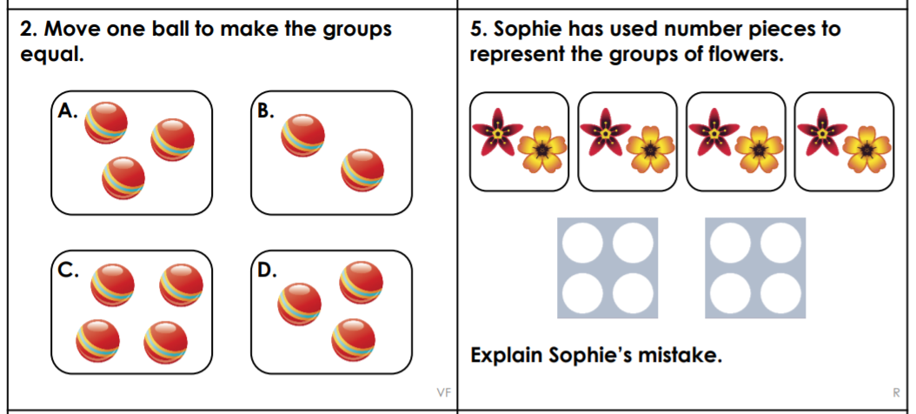

Slide 11
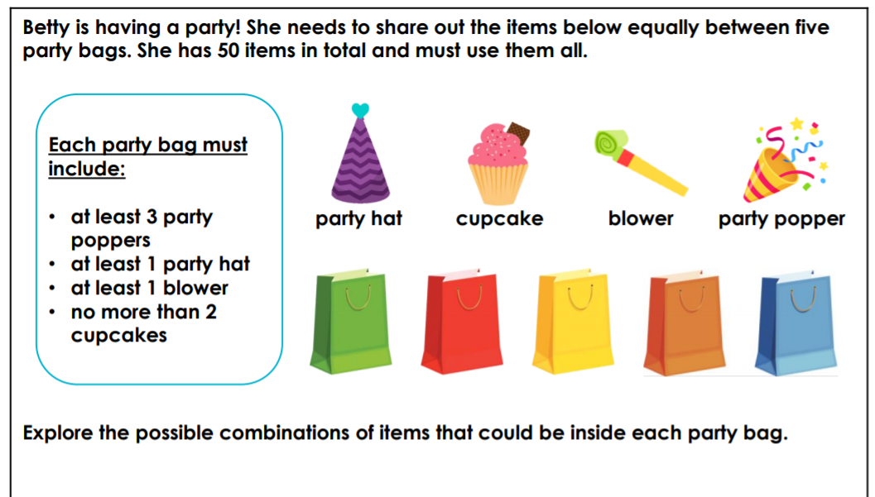
MATH INVESTIGATION
You may find it useful to use items in your home to represent the party bag objects, this will help you explore different combinations.

Slide 12
English

Slide 13
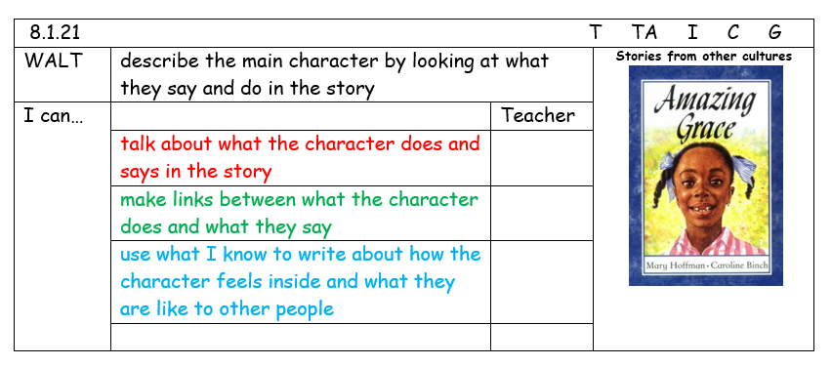
English: Today you are going to explore the character of Grace and her feelings.
You might want to listen to the story again.
With an adult please watch this video of the Amazing Grace story: https://www.youtube.com/watch?v=GArzTjbS2ls (Please supervise as the YouTube link contains outside adverts etc.)

Slide 14
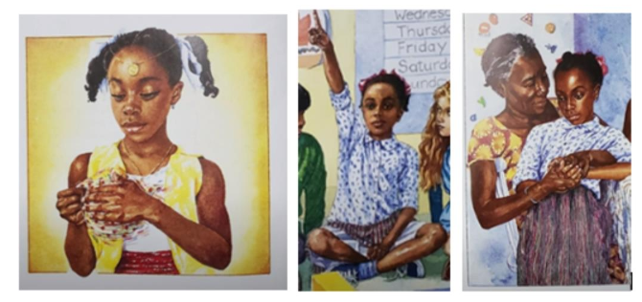
You will think about what others see about Grace on the outside (by what Grace does and the things she says) then look at Grace on the inside (by delving deeper into the idea that Grace went home to tell her family about her disappointment and did not share with friends or the teacher).
On a piece of paper draw the outline of Grace
Around the outside write some words that describe what Grace looks like, says and how she behaves
(confident, funny, enjoys acting)
Now on the inside describe how Grace is feeling
(sad, likes fairness, thoughtful)
Foundation: Try to sound out words to describe Grace
Year 1: Write words to describe Grace
Year 2: Have a go at writing you answer in a sentence.
You could ask an adult to take a photo of your answer and email it to me if you want to!

Slide 15
Art
We are learning to draw African Pattern Art.

Slide 16
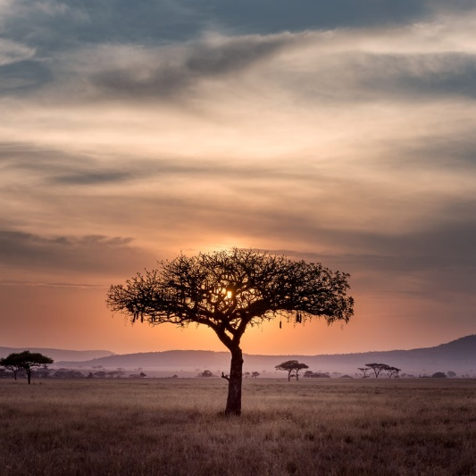
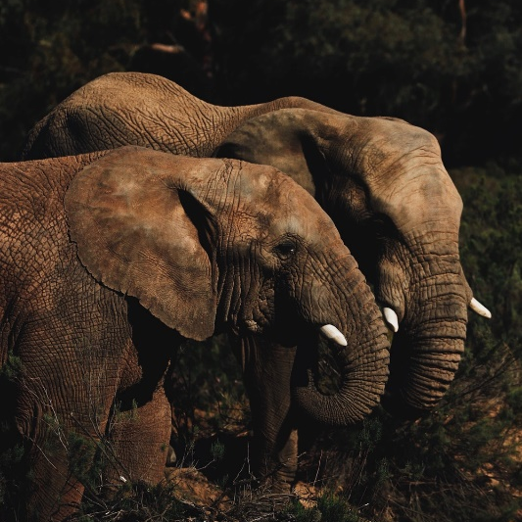
About Africa
Africa is the second largest continent in the world. It is made of 54 countries and 9 territories. It is estimated that there are 2000 different languages spoken in Africa.
Africa is home to rainforests, deserts, mountains, rivers and coastal plains.
Animals, such as the African elephant, giraffe, cheetah and the white and black rhinoceros, live in Africa.

Slide 17
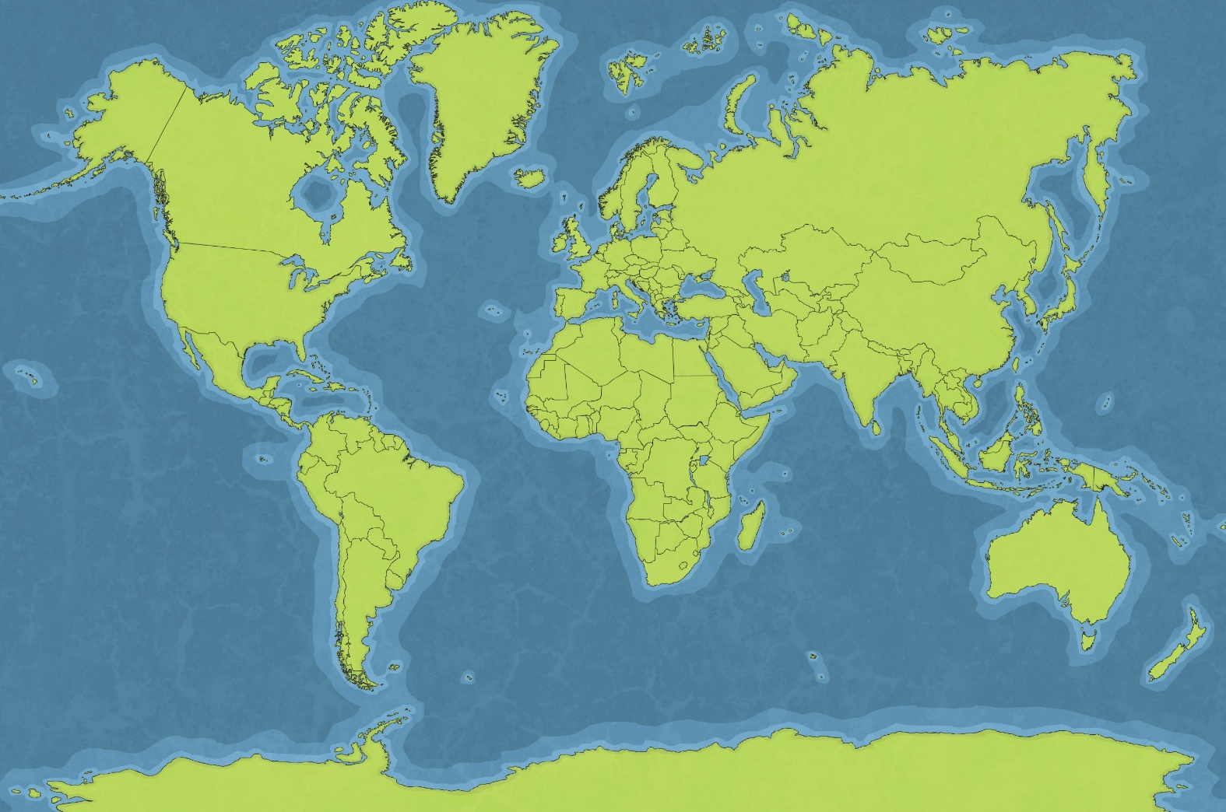
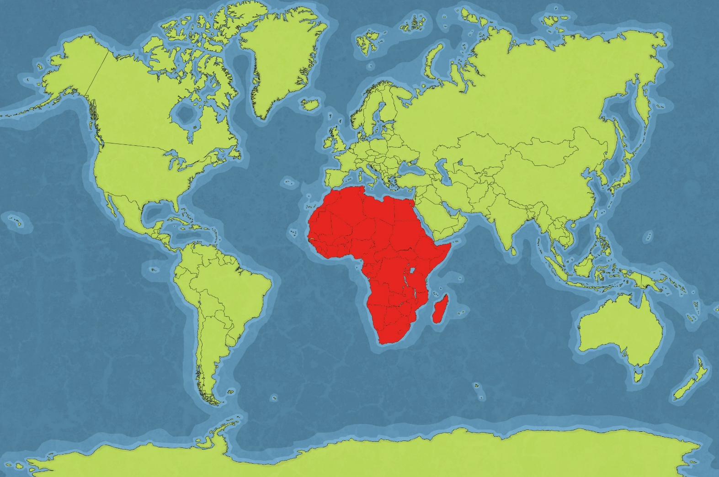
About Africa
Africa

Slide 18
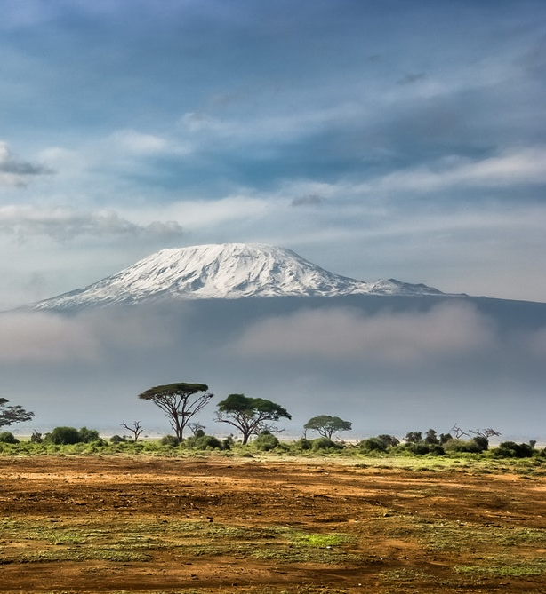
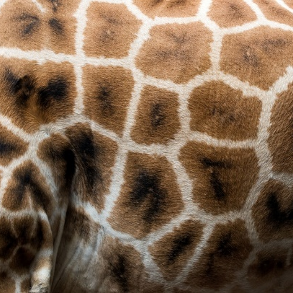
African Art
Africa is well known for its individual art.
For hundreds of years, African art has been strongly influenced by the environment and natural surroundings.
The vast richness and variety in the environment are ideal for encouraging creativity.

Slide 19
Can you use materials around your home to make a piece of art inspired by an African pattern.
You could cut up old packaging and stick it as a pattern
Or use your fingers to create dot art.

Slide 20
Well done!
I hope you had fun today and I look forward to doing more learning with you next week!
If you would like to share any of your learning with me, please ask an adult to take a photo and email it to me: aaskew@looeprimary.co.uk

